Slide 1
Dance
1700s and 1800s
Leah Feliciano
Pd. 6 AP American History

Slide 2
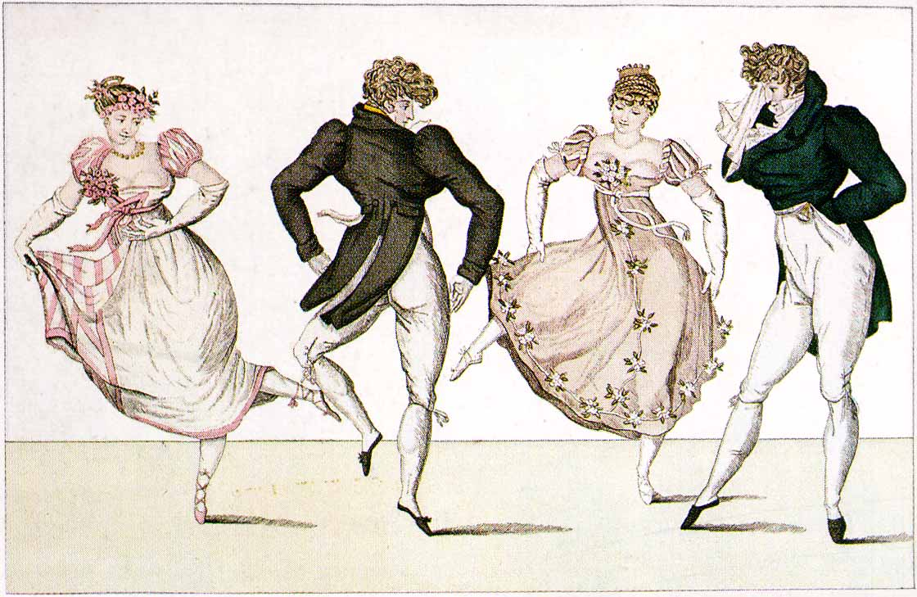
Contredanse
The contredanse was an 18th-century French development of the English country dance and was performed by French, German, and English aristocrats
Contredanses at first used only the country dance’s “longways” formations, in which each couple danced its way to the head of a double line (men on one side, women on the other)

Slide 3
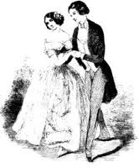
English Country-Dance
arranged for “as many couples as will” standing in lines, partner facing partner
The figures of over 25,000 dances were published with their music in English books between 1700 and 1830 and many more in Ireland and Scotland and Holland

Slide 4
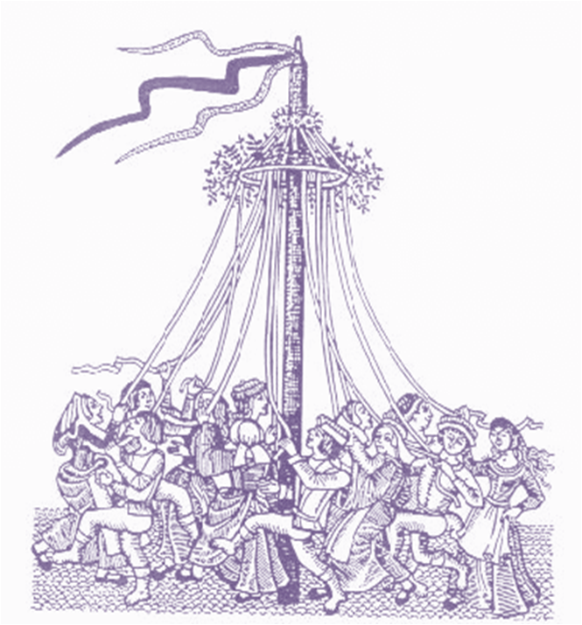
Maypole
Maypole dancing is a form of folk dance from western Europe, especially England, Sweden, Galicia, Portugal and Germany
dancers perform circle dances around a tall pole which is decorated with garlands, painted stripes, flowers, flags and other emblems
In a second most common form, dancers dance in a circle each holding a colored ribbon attached to a much smaller pole

Slide 5
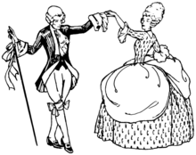
Minuet
is a social dance of French origin for two people
ballroom minuet was the chief dance of ceremony and ritual
it was a dramatic and powerful dance
The minuet has a complex basic step, but it is not a string of different steps as in other composed dances like gavottes or allemandes
In America, minuets opened most formal occasions, the Governor, senior military officer, leading merchant, or the host of the event dancing with the most senior ladies present

Slide 6
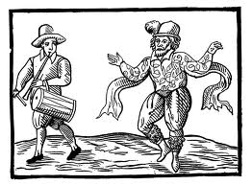
Clog Dancing
This type dancing was known as flatfooting, foot stomping and buck dancing and was generally an individual style of dance
It was a dance done in time with the music
  to the downbeat usually with the heel keeping rhythm
  traditionally done to old time string band music
The term "clogging" didn't come until later in the 1900s.

Slide 7
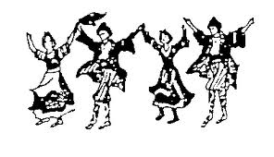
Contra Dancing
By the beginning of the 18th century these dances were common in the respective American colonies of England and France
Traditional
  Actives two-hand balance twice
  Two-hand turn, once and a half
  From this place the ladies chain
  Ladies chain back-actives two-hand balance twice two-hand turn, once and a half Back out, right and left through
  repeat

Slide 8
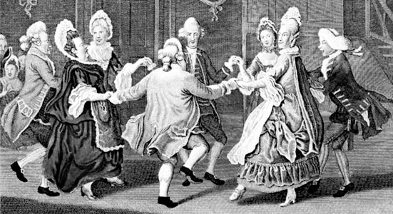
Cotillion
performed in a square of four couples
a cotillion consisted of a number of standard verses called “changes” followed by a chorus that was distinctive to that particular dance
the changes were movements such as circles, hand-turns, hands-across, allemande turns and rights-and-lefts (chain)
figure, or chorus, was repeated after each change
a cotillion might be performed with as many as eight or ten changes

Slide 9
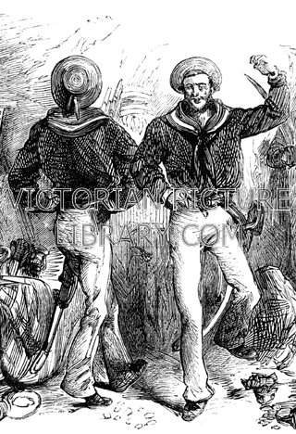
Hornpipe
Hornpipes are the vernacular dance forms for solo
footwork-focused dances which can be done in small spaces
Sailors always danced on board ship to make merry and keep fit

Slide 10
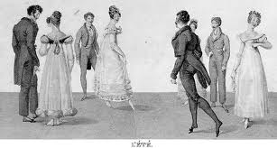
Quadrille
  late 18th- and 19th-century dance for four couples in square formation.
  Imported by English aristocrats in 1815 from elite Parisian ballrooms, it consisted of four, or sometimes five, contredanses
  Each of the quadrille’s sections was danced with prescribed combinations of figures, such as the tour de deux mains (“two-hand turn”), in which the couple held hands and turned; or the chaîne des dames (“ladies’ chain”), in which opposite women first passed each other by the right hand

Slide 11
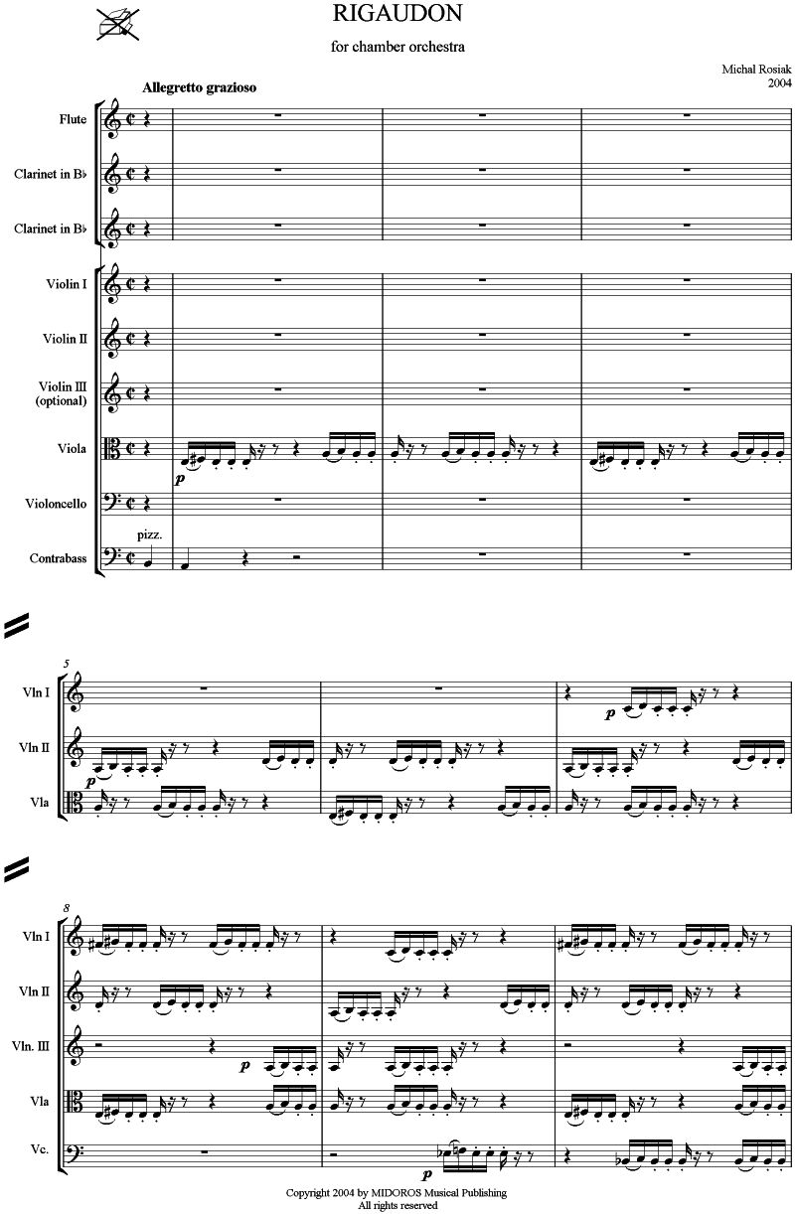
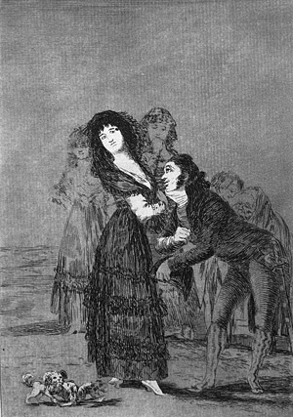
Rigaudon
French baroque dance with a lively diple metre
17th-century French folk dance for couples
popular as a court dance during the reign of Louis XIV

Slide 12
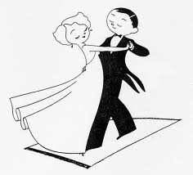
Viennese Waltz
fast-moving, challenging, and exciting dance
this dance requires stamina
born in the suburbs of Vienna and in the alpine region of Austria in the 1700’s
originally a folk dance
danced by peasants in Austria and Bavaria

Slide 13
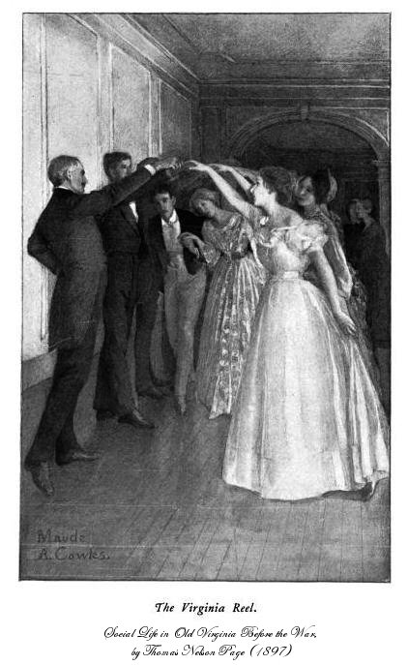
Virginia Reel
originally danced to a song which was known in England as Sir Roger De Coverley
The dance could be danced to any reel or hornpipe
The dance is danced in two lines, one line of gentlemen and one line of ladies

Slide 14
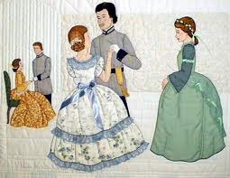
Waltz
  The waltz came to America around 1835 and was a standard dance in society by the mid 1800's.
  Waltz tempos are either fast (known as the "Vienna Waltz") or slow (known just as "Waltz", or, occasionally "Slow Waltz").
  The word "waltz" comes from the old German word for "to turn, roll or glide".
  Although waltz was originally danced to "classical" music, it is now danced in every style of music.

Slide 15
Q’s
  What is the second step in the Contra Dance?
    Ladies chain back
    actives two-hand balance twice
    Two-hand turn, once and a half
    Back out, right and left through
2. Is the English Country Dance danced with...
  women on one side men on the other.
  B. men circling a large pole erect in the ground.
  C. as many couples possible.
  D. none of the above.

Slide 16
3. Who is John Durang?
  The man who made the hornpipe famous.
  A theatrical dancer.
  A composer.
  Both A and B
4. Which of the following dances was danced in two lines, men on one side women on the other?
  Minuet and Contra Dance
  Virginia Reel and Contredanse
  Hornpipe and English Country Dance
  Cotillion and Viennese Waltz

Slide 17
The Riguadon originated where?
  Italy
  Germany
  France
  Both A and C
6. “Clogging” was also known as…
  flat footing
  foot stomping
  buck dancing
  all of the above

Slide 18
7. The Cotillion is performed in….
  a circle of eight couples.
  a square of eight couples.
  a square of four couples.
  lines of several couples.
8. The Viennese Waltz was danced by…
  peasants.
  aristocrats.
  noblemen.
  None of the above.

Slide 19
9. Who/What is Sir Roger De Coverley?
  A duke
  A dance
  A song
  A poem
10. Which dance was performed by dancing circle dances around a tall pole which is decorated with garlands, painted stripes, flowers, flags and other emblems?
  Maypole Dance
  Cotillion
  Viennese Waltz
  None of the above

Slide 20
11. What does tour de deux mains mean?
  Two hand turn
  Ladies arm chain
  None of the above
  “I like pasta”
12. When a dance has finished what should the gentleman ask the lady?
  For her hand in marriage
  To accompany him for a walk
  To introduce hi to her parents
  None of the above

Slide 21
13. Which way did the couples dance?
  Facing each other
  Side by side
  Back to back
  All of the above
14. Which was the main dance of the 1800s?
  Minuet
  Waltz
  Quadrille
  Cotillion

Slide 22
15. Couples dance to…
  Orchestra
  Piano
  Fiddle
  Both A and B

